Slide 1



SC Project
Iterative Methods for Computing Eigenvalues and Eigenvectors
Dev Utkarsh
November 2024

Slide 2

Table of Contents
1
The Use of Eigenvalues & Eigenvectors
5
Rayleigh Quotient Iteration (RQI)
2
Calculating Eigenvalues and Eigenvectors
6
Simultaneous Iteration Method
3
Power Iteration Method
7
QR Method
4
Inverse Iteration Method
8
Conclusion

Slide 3
What are EigenValues and EigenVectors
Eigenvalues and eigenvectors are fundamental concepts in linear algebra used to understand how matrices transform vectors.
Eigenvalue:
A scalar (λ) that represents how much the corresponding eigenvector is stretched or compressed during a linear transformation.
Eigenvalues indicate the amount of stretching (positive eigenvalue) or compression (negative eigenvalue) along those directions.

Slide 4
The Use of Eigenvalues & Eigenvectors
Eigenvalues and eigenvectors are more than just mathematical concepts; they are fundamental to understanding real-world phenomena:
Stability analysis in engineering
Data dimensionality reduction in machine learning etc
In the business world, they can help in optimizing resource allocation. In education, they assist in data analysis for improving learning outcomes. They showcase the interconnectedness of various disciplines.

Slide 5
Calculating Eigenvalues and Eigenvectors
To calculate eigenvalues and eigenvectors, we usually solve the equation A*x = λ*x, where A is a matrix, x is an eigenvector, and λ is the eigenvalue.
For simplicity, consider a 2x2 matrix: A = [[4, 2], [1, 3]]. We would find its eigenvalues by setting up the characteristic polynomial, det(A - λI) = 0.
This leads us to a quadratic equation which, when solved, provides the eigenvalues. Each eigenvalue corresponds to an eigenvector, dependent on the matrix's properties.
The process, while straightforward for small matrices, becomes increasingly complex for larger ones, necessitating advanced techniques.
.

Slide 6
Power Iteration Method
The Power Iteration method is our first stop in this exploration. It focuses on identifying the dominant eigenvalue, which is the largest in magnitude.
Starting with a random vector, we repeatedly multiply it by the matrix and normalize the result after each multiplication.
This iterative process converges to the eigenvector that corresponds to the largest eigenvalue, making it simple yet powerful for certain applications.
It’s particularly useful for sparse matrices, where traditional techniques falter due to computational constraints.

Slide 7
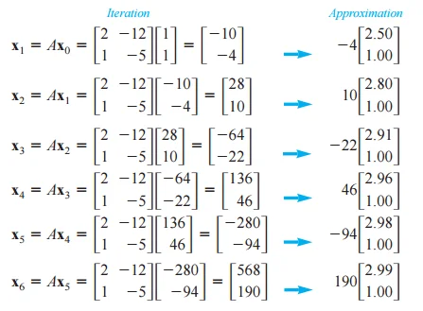
Power Iteration Method

Slide 8
Inverse Iteration Method
Next, we examine Inverse Iteration, a technique aimed at uncovering the smallest eigenvalue of a matrix.
This method involves iterating on the inverse of the matrix by solving a series of linear systems, allowing for precise explorations of eigenvalues.
Shifted Inverse Iteration can further adapt this method to find eigenvalues near a desired target by applying a shift to the matrix.
These strategies work well with both large and small matrices, providing flexibility in applications.

Slide 9
Rayleigh Quotient Iteration (RQI)
Rayleigh Quotient Iteration enhances the Inverse Iteration by dynamically updating the shift based on the Rayleigh quotient, improving convergence rates.
This method is particularly efficient for symmetric matrices, often achieving cubic convergence as we get closer to the true eigenvalue.
By refining our approach to finding eigenvalues, RQI ensures better accuracy and speed.
This is vital in scenarios where precision and performance are paramount, such as in scientific computations.

Slide 10
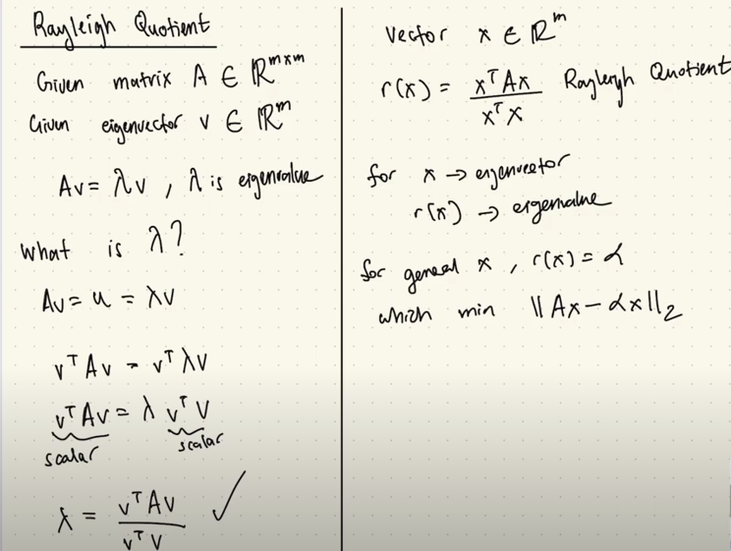

Slide 11
Simultaneous Iteration Method
The Simultaneous Iteration method allows for the computation of multiple eigenvalues and eigenvectors at once, leveraging power iteration on various starting vectors.
This is particularly useful in symmetric matrices, ensuring that the resulting eigenvectors remain orthogonal to one another.
By computing several eigenvalues concurrently, we can save significant computational time and resources.
This method shines in applications where multiple features or components need to be analyzed together, such as in data analysis.

Slide 12
QR Method
The QR Method utilizes matrix factorization to reach eigenvalues efficiently. It decomposes the matrix into orthogonal (Q) and upper triangular (R) factors repeatedly.
After several iterations, this method allows the matrix to converge to a diagonal form where the eigenvalues can easily be identified.
Multiply R and Q in reverse order: Anew = RQ.This produces a new matrix Anew which is similar to A but closer to a diagonal form
After many iterations, the matrix Anew​ converges to a diagonal matrix (or nearly diagonal), where the diagonal entries are the eigenvalues of A.

Slide 13
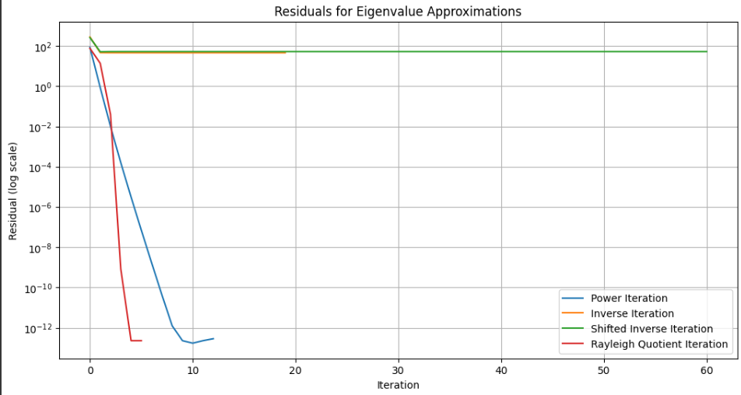
Conclusions

Slide 14
Conclusions
Using the code from the papers and implementing it, and plotting the difference between the exact eigenvalues and the approximate, we get:
Rayleigh performed the best, less iterations and faster convergence.
Then the power method, faster than the inverse method and shifted inverse.
Shifted method did not perform so well in the code.
Each method has its strengths, catering to different types of matrices and eigenvalue challenges, enhancing our computational efficiency.

Slide 15
Conclusion
In wrapping up, we find that these iterative methods are invaluable tools for tackling the complexities of eigenvalue problems, especially in large-scale scenarios.
Refinements to these techniques, like shifts and matrix reduction, further boost convergence speed and practicality in applications.
Understanding these methods paves the way for innovations across fields, from engineering to data science and beyond.

Slide 16
Thank You!

